Slide 1


INFT 1012 Network Fundamentals
Week 3 – Topic Outline and Highlights

Slide 2
Topics
Physical layer
Purpose of Physical Layer Network Connections and Media
Data Link Layer
Purpose of Data Link Layer
Media Access Control (MAC)
Ethernet
Ethernet Protocol
MAC sublayer
Ethernet MAC Addresses
Ethernet Frame
LAN/Ethernet Switches

Slide 3
Readings
CCNAv7: Introduction to Networks course text & quizzes
Module 4 – Sections 4.0, 4.1 & 4.2
Module 6 – Sections 6.0, 6.1.1, 6.1.3 & 6.2
Module 7 – Sections 7.0, 7.1, 7.2, 7.3
Available at: www.netacad.com

Slide 4
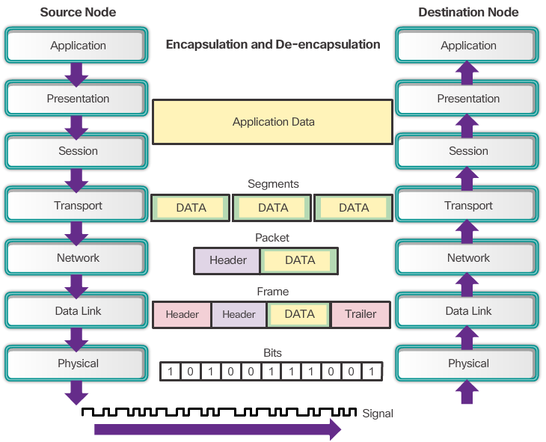
Purpose of Physical Layer
The OSI physical layer provides the means to transport the bits that make up a data link layer frame across the network media
Accepts a complete frame from the data link layer
Encodes the frames and creates the electrical, optical, or radio wave signals that represent the bits in each frame.
Sends the signals on the media, one at a time.
Passes the bits up to the data link layer as a complete frame.
Restores them to their bi. representations
Retrieves these individual signals from the media.

Slide 5
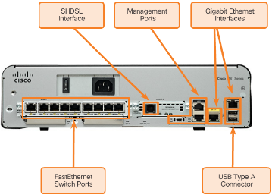
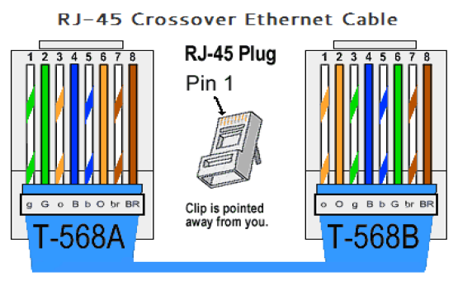
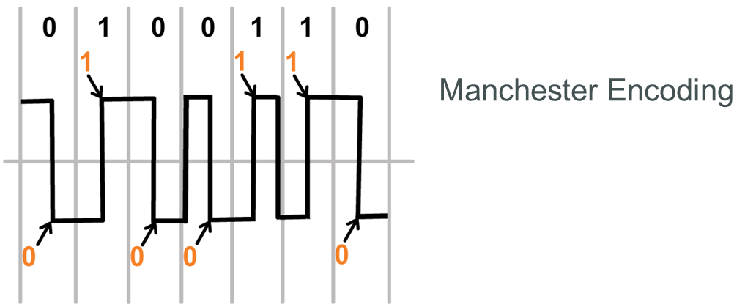
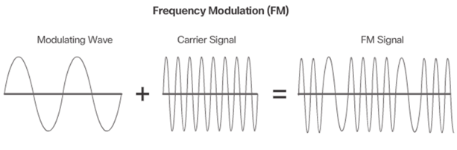
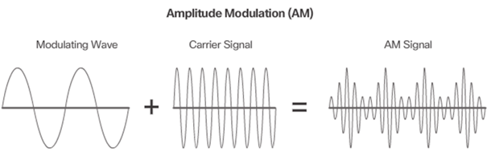
Physical Layer Standards/Protocols
The physical layer standards/protocols address three functional areas:
Physical Components
Hardware components such as NICs, interfaces and connectors, cable materials, and cable designs are all specified in standards associated with the physical layer.
Encoding
Methods for converting a stream of data bits into a predefined "code”, i.e. predictable patterns that can be recognized by both the sender and the receiver.
Signaling
Methods specifying how the bit values "1s" and "0s" (digital signals) are represented on the physical media for transmission.

Slide 6
Bandwidth vs Throughput
Bandwidth is the capacity of a medium to carry data, the amount of data that can flow from one place to another in a given amount of time. – what’s in theory
Bandwidth is typically measured in kilobits per second (kb/s), megabits per second (Mb/s), or gigabits per second (Gb/s).
Factors determining the practical bandwidth of a network:
Properties of the physical media
Technologies chosen for signaling and detecting network signals
The laws of physics all play a role in determining the available bandwidth.
Throughput is the measure of the transfer of bits across the media over a given period of time. – what’s in real life
Throughput usually does not match the specified bandwidth
Factors influence throughput:
The amount of traffic
The type of traffic
The latency created by the number of network devices encountered between source and destination
Notes:
Bandwidth is sometimes thought of as the speed that bits travel, however this is not accurate. For example, in both 10Mb/s and 100Mb/s Ethernet, the bits are sent at the speed of electricity. The difference is the number of bits that are transmitted per second.

Slide 7
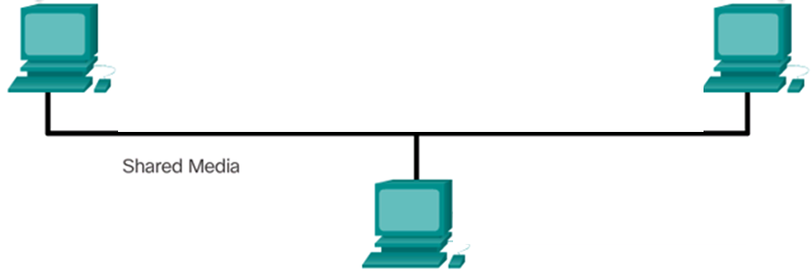
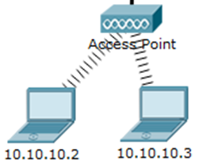

Types of Connections
Wired connections:
Require physical cables
Need NIC on device
Connections can be via cable directly or through a switch (e.g. in an Ethernet LAN)
Wireless connections:
Data transmitted using radio waves
Need wireless NIC on device
In a wireless LAN,
Devices need to connect to a Wireless Access Point (AP)
The further is from the AP, the weaker the signal a device receives
All devices connecting to the same wireless AP share access to the airwaves

Slide 8
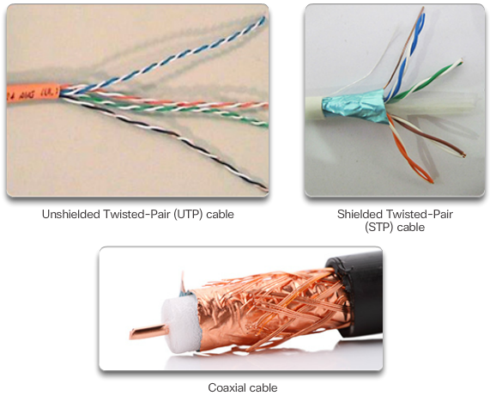
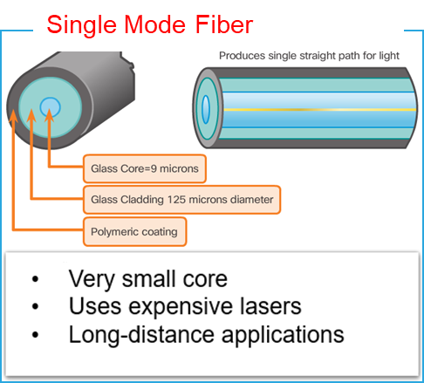
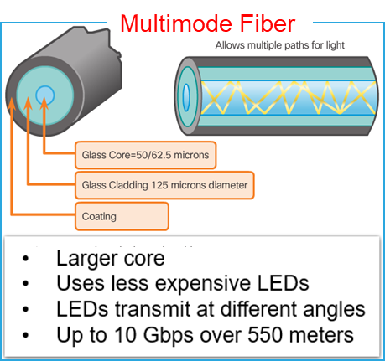
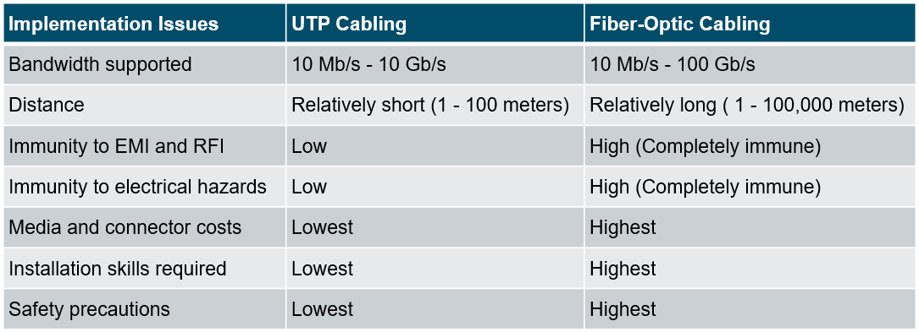
Copper & Fiber Media

Slide 9

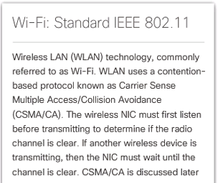


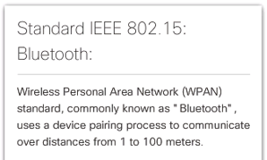
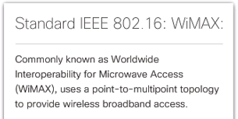
Wireless Media
Zigbee
Standard IEEE 802.15.4
Low data-rate, low power-consumption communications, primarily for Internet of Things (IoT) applications
Provides the greatest mobility options of all media, and now the primary way users connect to home and enterprise networks.
Concerns about wireless media:
Coverage: Works well in open environments, but certain construction materials and the local terrain will limit the effective coverage.
Interference: Susceptible to interference and can be disrupted by common devices, e.g. cordless phones, some types of fluorescent lights, microwave ovens.
Security: Easier to gain access to wireless transmission. Network security is a major component of wireless network administration.
Shared medium: The wireless medium is shared amongst all wireless users. The more users, the less bandwidth for each user.

Slide 10
Purpose of Data Link Layer
The OSI data link layer prepares network data for the physical network. It is responsible for communications between two adjacent nodes, or precisely two adjacent network interface cards (NICs).
Accepts a complete IP packet from the Network layer
Encapsulates the packet in a frame
Passes the frame down to the physical layer to be transmitted over the media to the next adjacent node
Passes the packets up to the network layer.
De-encapsulates IP packet and conduct other functions such as error detection
Receives complete frames from physical layer

Slide 11
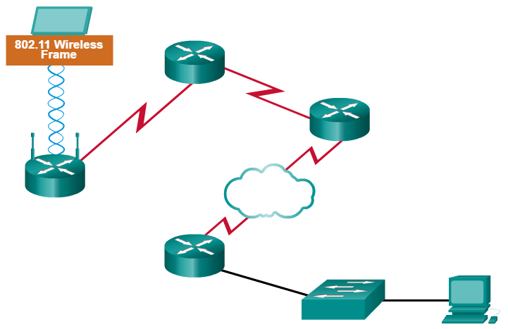

Providing Access to Media
The technique used for getting the frame on and off the media is called the media access control method.
Data link layer protocols govern how to format a frame for use on different media.
At each hop along the path, an intermediary device accepts a frame from one medium, de-encapsulates the frame and forwards the packet after encapsulating it in a new frame. The headers of each frame are formatted for the specific media that it will cross.
Different protocols may be used for different media.
Network layer does not need to worry about what types of media used along the path.
Paris
Japan
Notes:
As packets travel from the source host to the destination host, they typically traverse over different physical networks. These physical networks can consist of different types of physical media such as copper wires, optical fibers, and wireless consisting of electromagnetic signals, radio and microwave frequencies, and satellite links.
Without the data link layer, network layer protocols such as IP, would have to make provisions for connecting to every type of media that could exist along a delivery path. Moreover, IP would have to adapt every time a new network technology or medium was developed. This process would hamper protocol and network media innovation and development. This is a key reason for using a layered approach to networking.

Slide 12
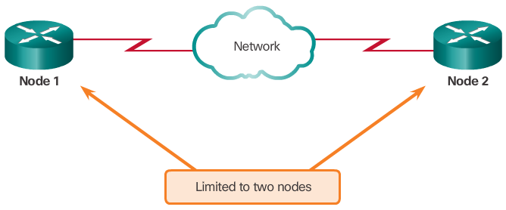
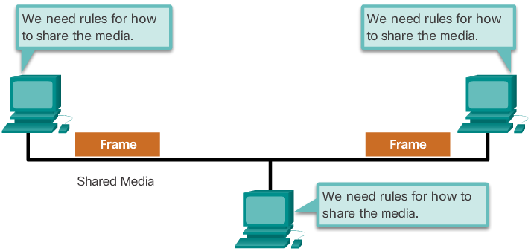
Controlling Access to the Media
Media access control is the equivalent of traffic rules that regulate the entrance of motor vehicles onto a roadway.
The actual media access control method used depends on:
Topology - How the connection between the nodes appears to the data link layer.
Media sharing - How the nodes share the media.
For shared media, two media access control approaches: Contention-based access and controlled access.
In a point-to-point topology, such as the WAN connection shown, no need for media access control, as two nodes do not have to share the media with other hosts, and a node does not have to make any determination about whether an incoming frame is destined for it or another node

Slide 13
Contention Based Access – CSMA/CD & CSMA/CA
Carrier Sense Multiple Access (CSMA): Listen before talk!
Before transmitting, a device determines if anyone else is transmitting on the shared medium, and only transmits if the medium is considered available.
If two devices transmit at the same time, a collision will occur.
CSMA/CD (Collision Detection):
Used in legacy half-duplex Ethernet LANs
A device detects the collision on the network. This is done by the NIC comparing data transmitted with data received, or by recognizing the signal amplitude is higher than normal on the media.
Modern Ethernet LANs use switches, and do not use a contention-based system because the switch and the host NIC operate in full-duplex mode.
CSMA/CA (Collision Avoidance):
Used in Wireless LANs (WLANs). Instead of detecting collisions, a wireless device attempts to avoid collisions, as in wireless environment, it may not be possible to detect a collision (weaker signals).
Each device that transmits includes the time duration that it needs for the transmission.
All other wireless devices receive this information and know how long the medium will be unavailable.
The receiver returns an acknowledgment so that the sender knows the frame arrived.

Slide 14
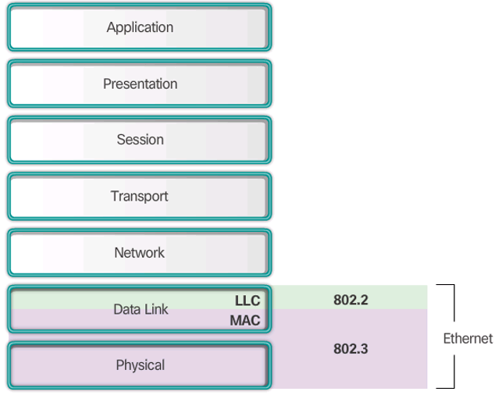
Ethernet and Ethernet Standards
Ethernet is one of the two LAN technologies used today (the other is WLAN), operating in the data link layer and the physical layer
Supports data bandwidths of 10, 100, 1000, 10,000, 40,000, 100,000 Mbps (100 Gbps)
Ethernet standards is a family of networking technologies defined in
the IEEE 802.2 and 802.3 standards
802.2 defines the Logical Link Control (LLC)
sublayer of data link layer,
Handles communications with the upper layer
and the lower layer
Implemented as driver software for the NIC
in a computer
802.3 defines Media Access Control (MAC)
sublayer of the data link layer and Physical layer
Primary responsibilities: Data encapsulation and Media access control
Implemented by hardware, typically in the computer NIC

Slide 15
MAC Sublayer
Data encapsulation
The MAC layer adds a header and trailer to the network layer PDU, to form the Ethernet frame.
The use of frames aids in the transmission of bits as they are placed on the media and in the grouping of bits at the receiving node.
The frame header and trailer provides three primary functions:
Frame delimiting - The delimiting bits in a frame provide synchronization between the transmitting and receiving nodes, identifying a group of bits that make up a frame.
Addressing - Source and Destination MAC addresses provide for data link layer addressing.
Error detection - Each frame contains a trailer used to detect any errors in transmissions.
Media Access Control (MAC)
CSMA/CD process is used in half-duplex Ethernet LANs
Today’s Ethernet LANs use full-duplex switches, allowing multiple devices to send and receive simultaneously with no collisions.
Notes:
5.1.1.2 Mac Sublayer

Slide 16
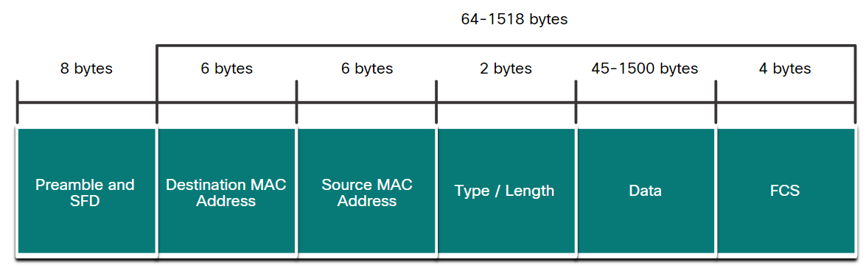
Ethernet Frame
Minimum frame size: 64 bytes. Frames smaller than 64 bytes is considered a “collision fragment” or “runt frame”
Maximum frame size: 1518 bytes. Frames larger than 1500 bytes are called Jumbo or Baby Giant frames
If the size of a transmitted frame is less than the minimum or greater than the maximum, the receiving device drops the frame.
Preamble field is not included when describing the size of a frame.

Slide 17
MAC Address: Ethernet Identity
Each NIC has a unique MAC address
Represented as a 48-bit binary value expressed as 12 hexadecimal digits.
Often written as 6 sections of 2 hex digits (i.e. 1 byte), separated by “:” or “-”
Example: 00:60:2F:3A:07:BC, or 00-60-2F-3A-07-BC
Sometimes (e.g. Cisco routers and switches) use the form of 3 sections of 4 hex digits (2 bytes), separated by “.”, e.g. 0060.2F3A.07BC
MAC address also known as Ethernet address, physical address, burned-in address, or data link layer address
Two parts:
First 24 bits are OUI (Organisationally Unique Identifier)
Remaining 24 bits are Vendor Assigned value

Slide 18

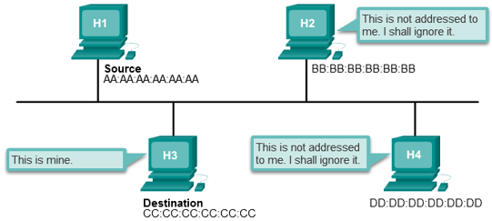
Frame Processing by Hosts
A NIC views the frame to see if the destination MAC address in the frame matches the device’s MAC address stored in RAM.
If there is no match, the device discards the frame.
If there is a match, the NIC passes the frame up, and the de-encapsulation process takes place at the device.
Note: A device also accepts a frame if it is a frame broadcast to all hosts in the network or a frame multicast to a group to which the device belongs to.

Slide 19
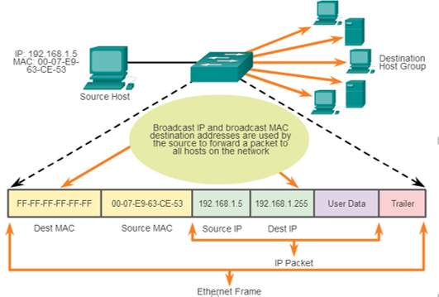
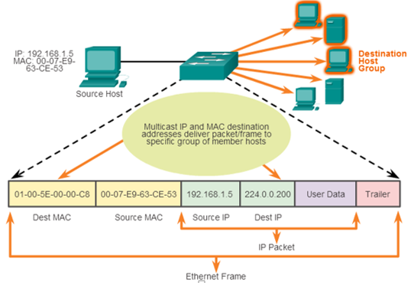
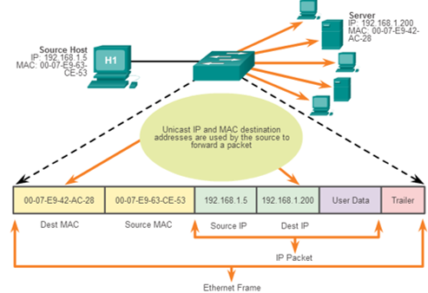
Broadcast, multicast, & Unicast MAC Addresses

Slide 20
Switch Fundamentals
An Ethernet Switch is a Layer 2 device.
It uses MAC addresses to make forwarding decisions.
The MAC address table is sometimes referred to as a content addressable memory (CAM) table.
An Ethernet Switch creates its MAC address table through “self-learning”, by examining the source MAC address of the frames received on a port.
The switch forwards frames by searching for a match between the destination MAC address in the frame and an entry in the MAC address table. If no match is found, the switch will forward the frame to all active ports except the incoming port.

Slide 21
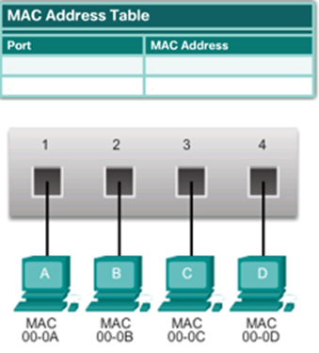
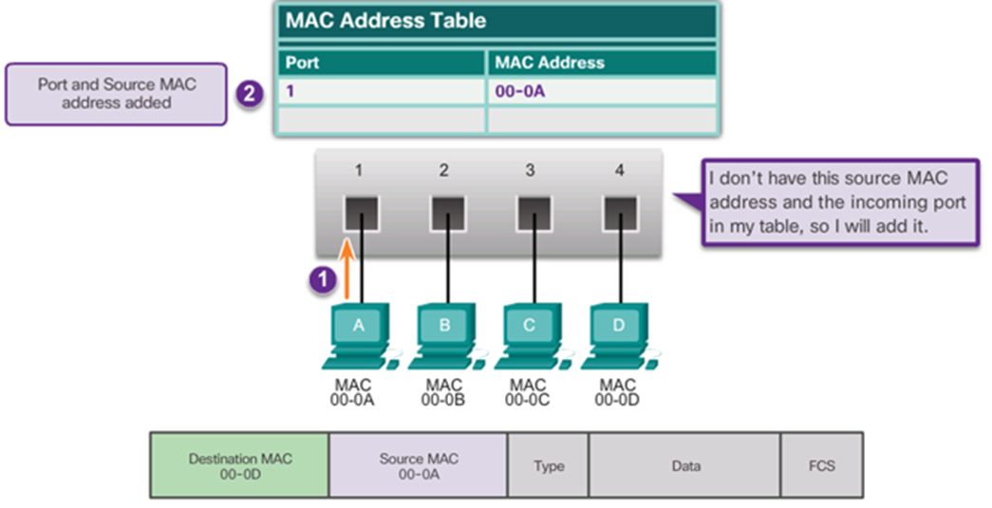
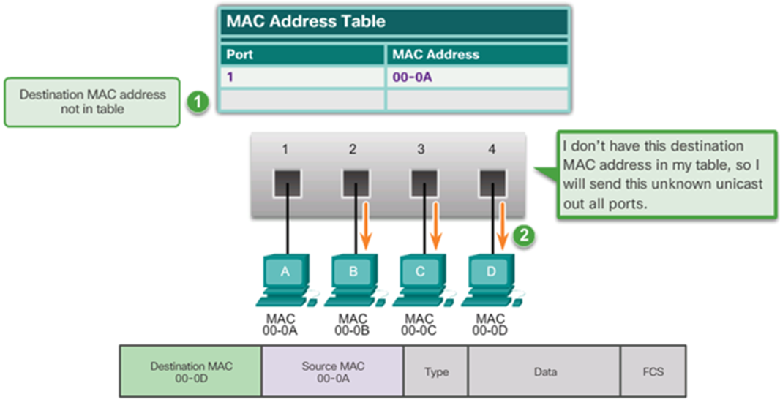
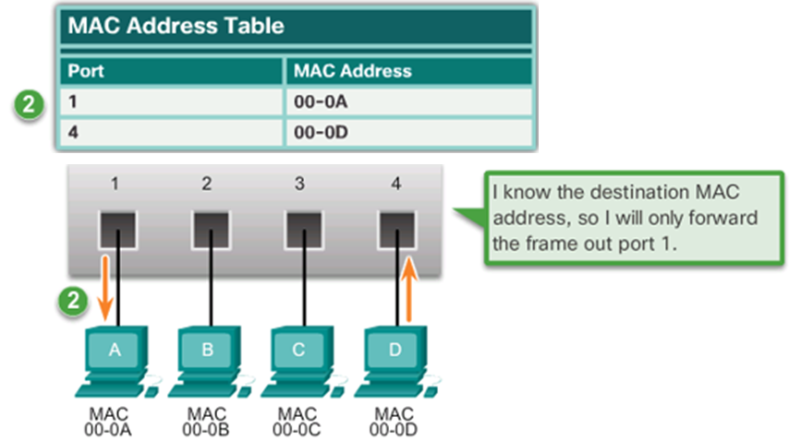
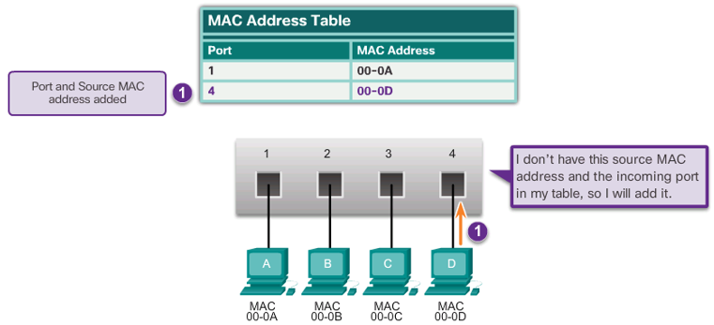

Switch Learning and Forwarding

Slide 22
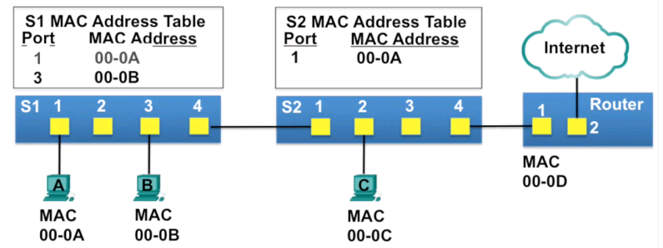
Switch Learning and Forwarding
A switch can have multiple MAC addresses associated with a single port.
This is common when the switch is connected to another switch.
The switch will have a separate MAC address table entry for each frame received with a different source MAC address.
In the example, S2 has two entries for its Port 1, due to PC A and PC B both sending frames to PC C via the same port, Port 1 on S2

Slide 23
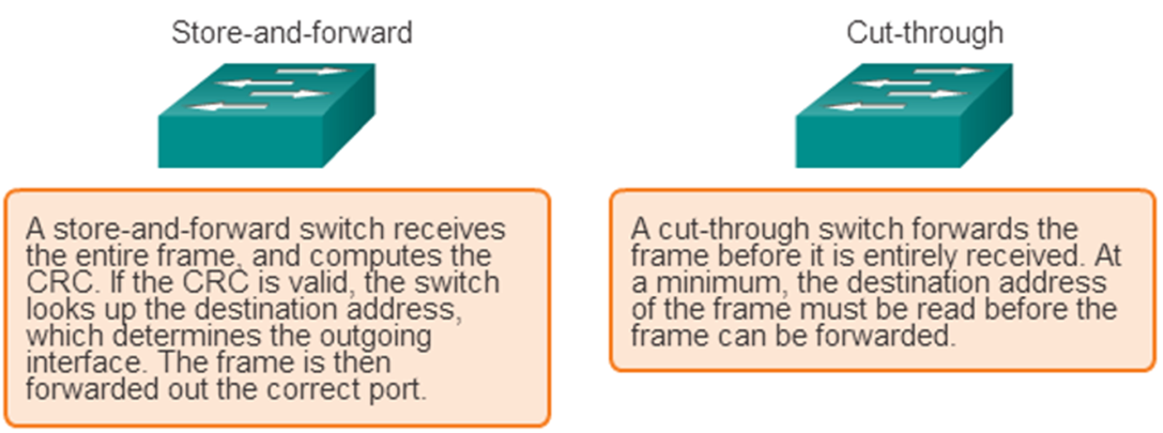
Frame Forwarding Methods on Cisco Switches
Cut-through switching is the predominant switching method used on Cisco switches.
Two types of cut-through switching:
Fast-forward switching:
Lowest level of latency immediately forwards a packet after reading the destination address.
Typical cut-through method of switching.
Fragment-free switching:
Switch stores the first 64 bytes of the frame before forwarding.
Most network errors and collisions occur during the first 64 bytes.

